Slide 1

SIMPLE LIFE
江建德、許家維、陳俊甫、楊子權、陳聿懷、呂昶毅、許庭柯

Slide 2
Requirement
The user is able to use their cellphone app to send commands to a main controller through a WiFi connection.
A signal emitter and a signal receiver form a signal connection, which is registered to the main controller with an ID. Signal emitters are installed on the main controller, and signal receivers are installed on electronic appliances.
The main controller contains a decision maker, which may decide to perform operations on the appliances through user predefined schedule.
The cloud server is provided by us, and all the main controllers will download data from this server.

Slide 3
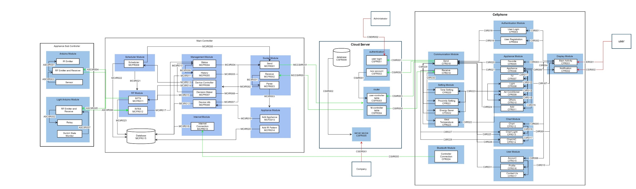
System Architecture

Slide 4
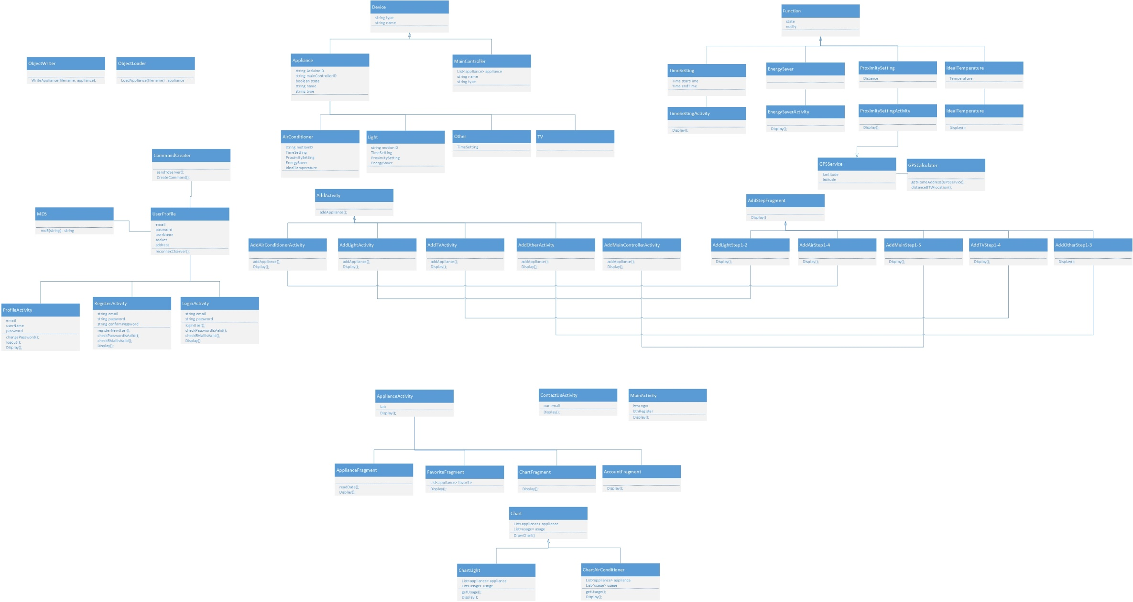
Cellphone Class Diagram

Slide 5
Cellphone code
Abstract Factory
Observer pattern

Slide 6
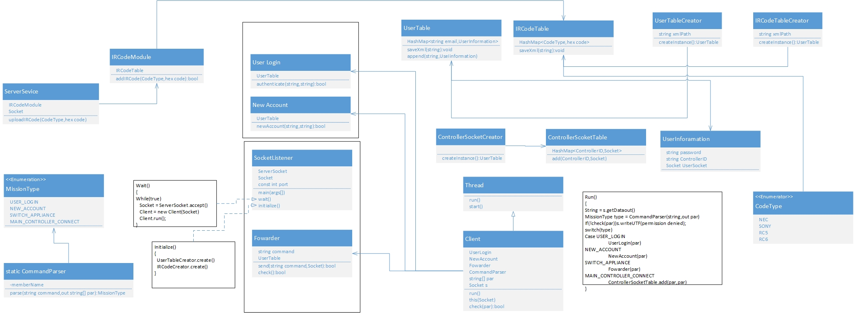
Cloud Server Class Diagram

Slide 7
Cloud server code
Factory Pattern
UserTableCreator
ControllerSocketTableCreator

Slide 8
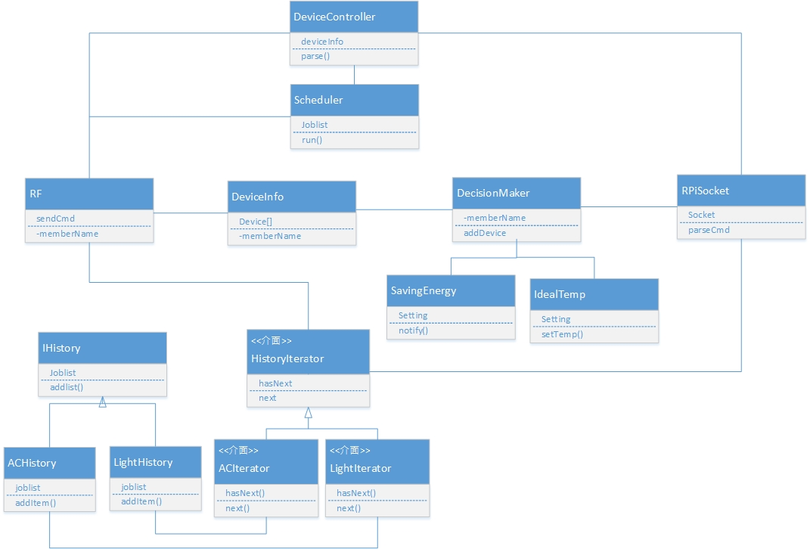
Main Controller Class Diagram

Slide 9
Main controller code
Iterator pattern
ACIterator (ArrayList)
LightIterator (Array)

Slide 10
Command Type
Commands between server, cell phone and main controller
Register: /Register [email] [password]
par[0] = email(username)
par[1] = password
Login: /Login [username] [password]
par[0] = username
par[1] = password
Add Main Controller: /AddMC [username] [password] [MCID] [username]
par[0] = username
par[1] = password
par[2] = Main Controller ID
par[3] = username
Main Controller Connect: /MCConnect [MCID]
par[0]= MCID
Control Appliance: /ControlAppliance [username] [password] [MCID] [Device Type] [Device ID] [cmd]
par[0] = username
par[1] = password
par[2] = MCID………

Slide 11
Return value meaning
Server Return Code
R000: Register failure, email exists
R001: Register success
R002: Login Success
R003: Login failure, username not found
R004: Login failure, password incorrect
R005: Add MC success
R006: Add MC failure, ID not exist or controller doesn’t connect to server
R007: Authenticate failure, username or password incorrect
R008: Main Controller connect success
R009: Main Controller connect failure, controller id not found
R010: Command forward success
R011: Command forward failure
R012: Password change success ……..

Slide 12
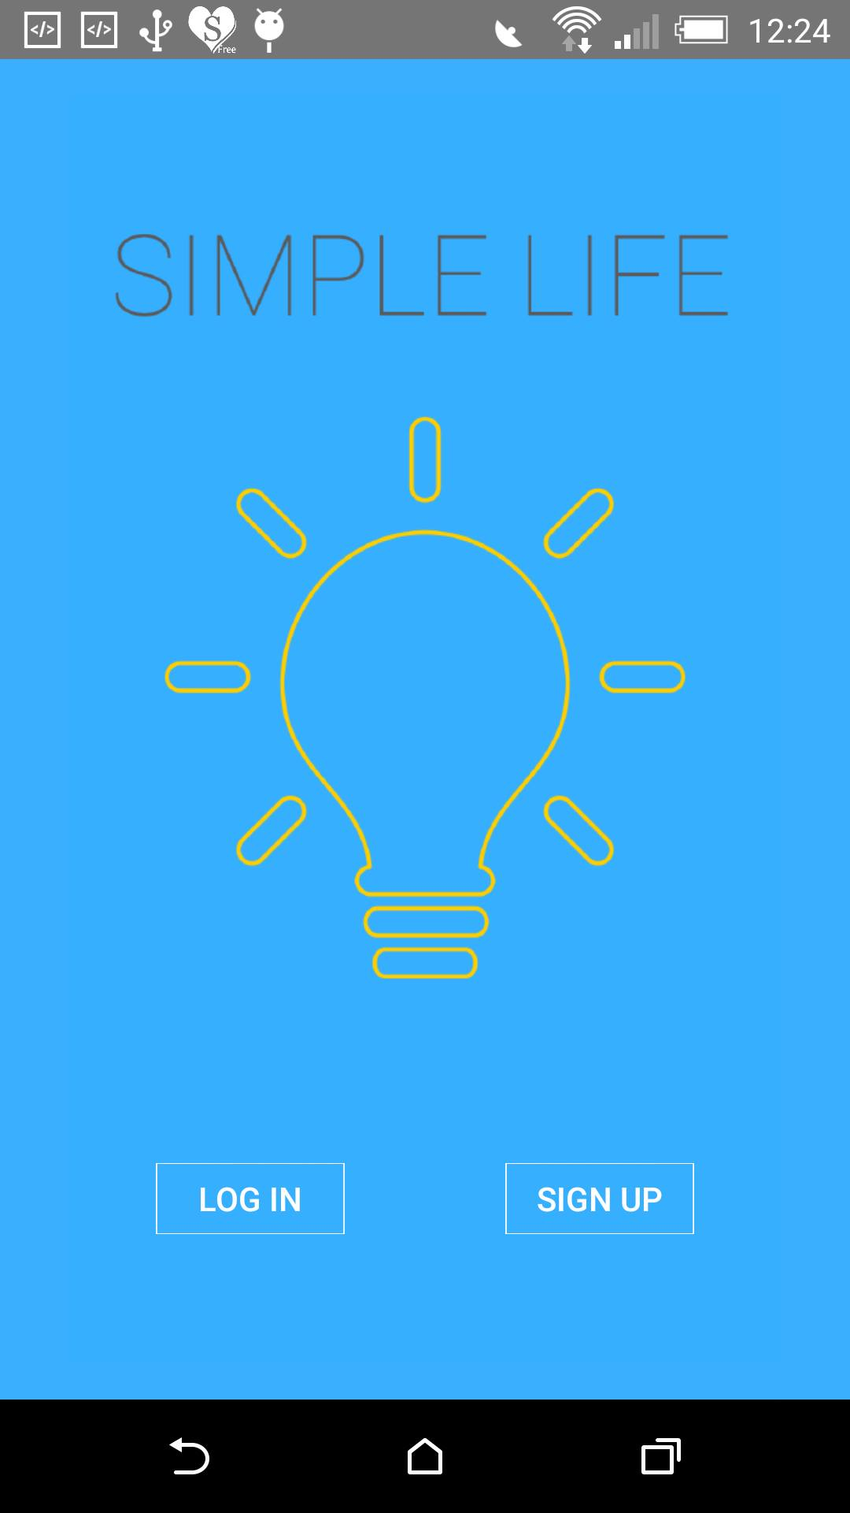
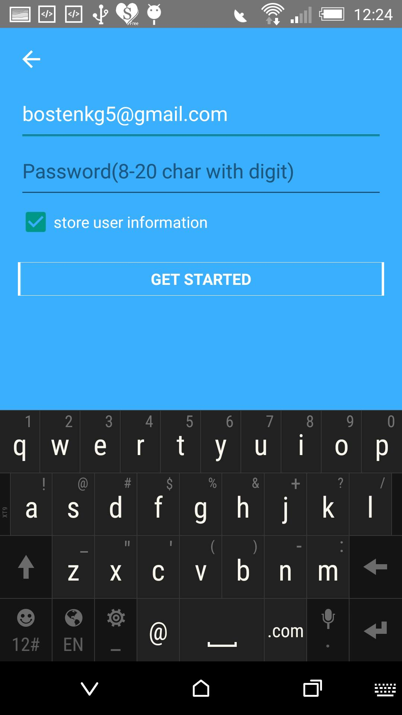
System Implementation
Login with constraint
Password is encoded with MD5 encoder
Home Page

Slide 13
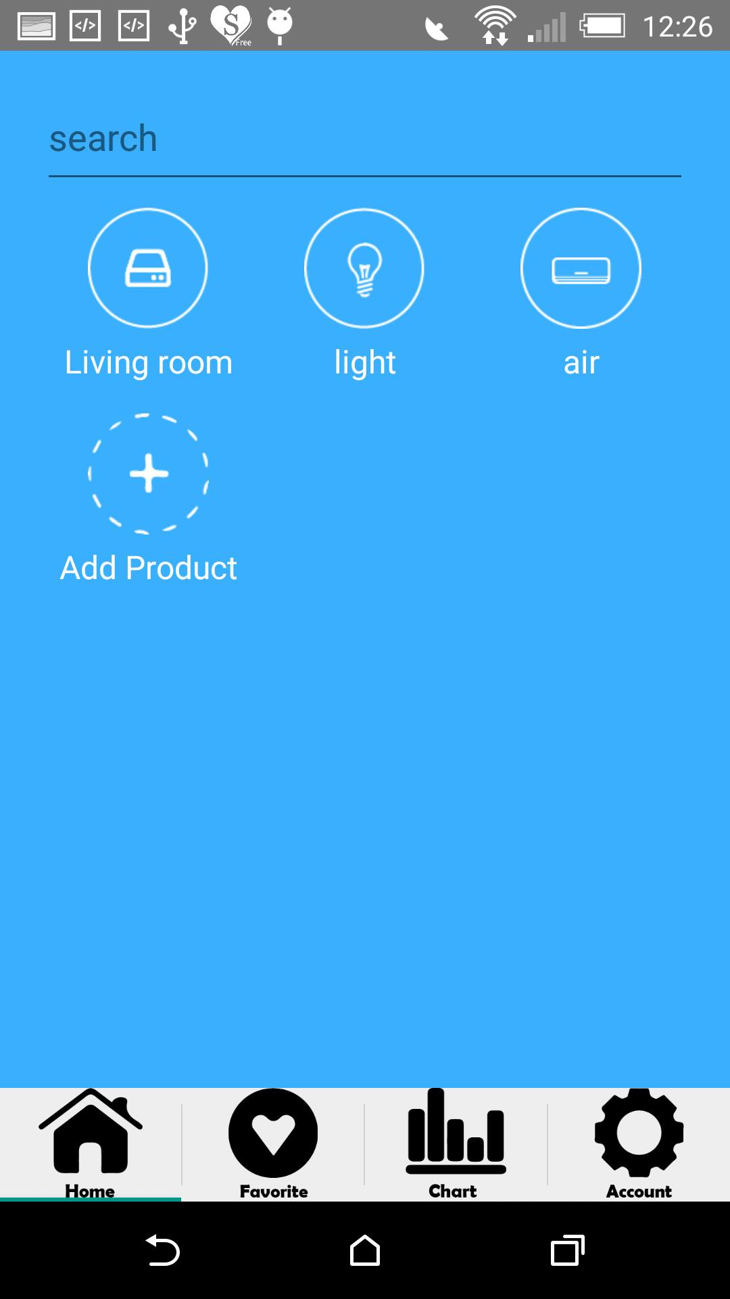
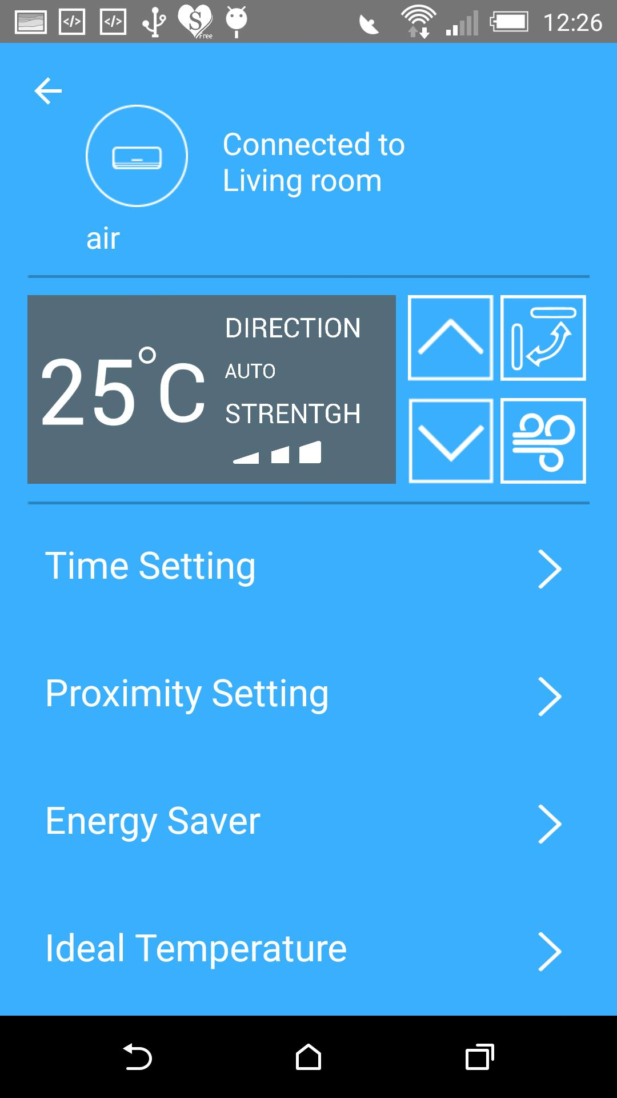
System Implementation
Appliance with function setting
Main Page

Slide 14
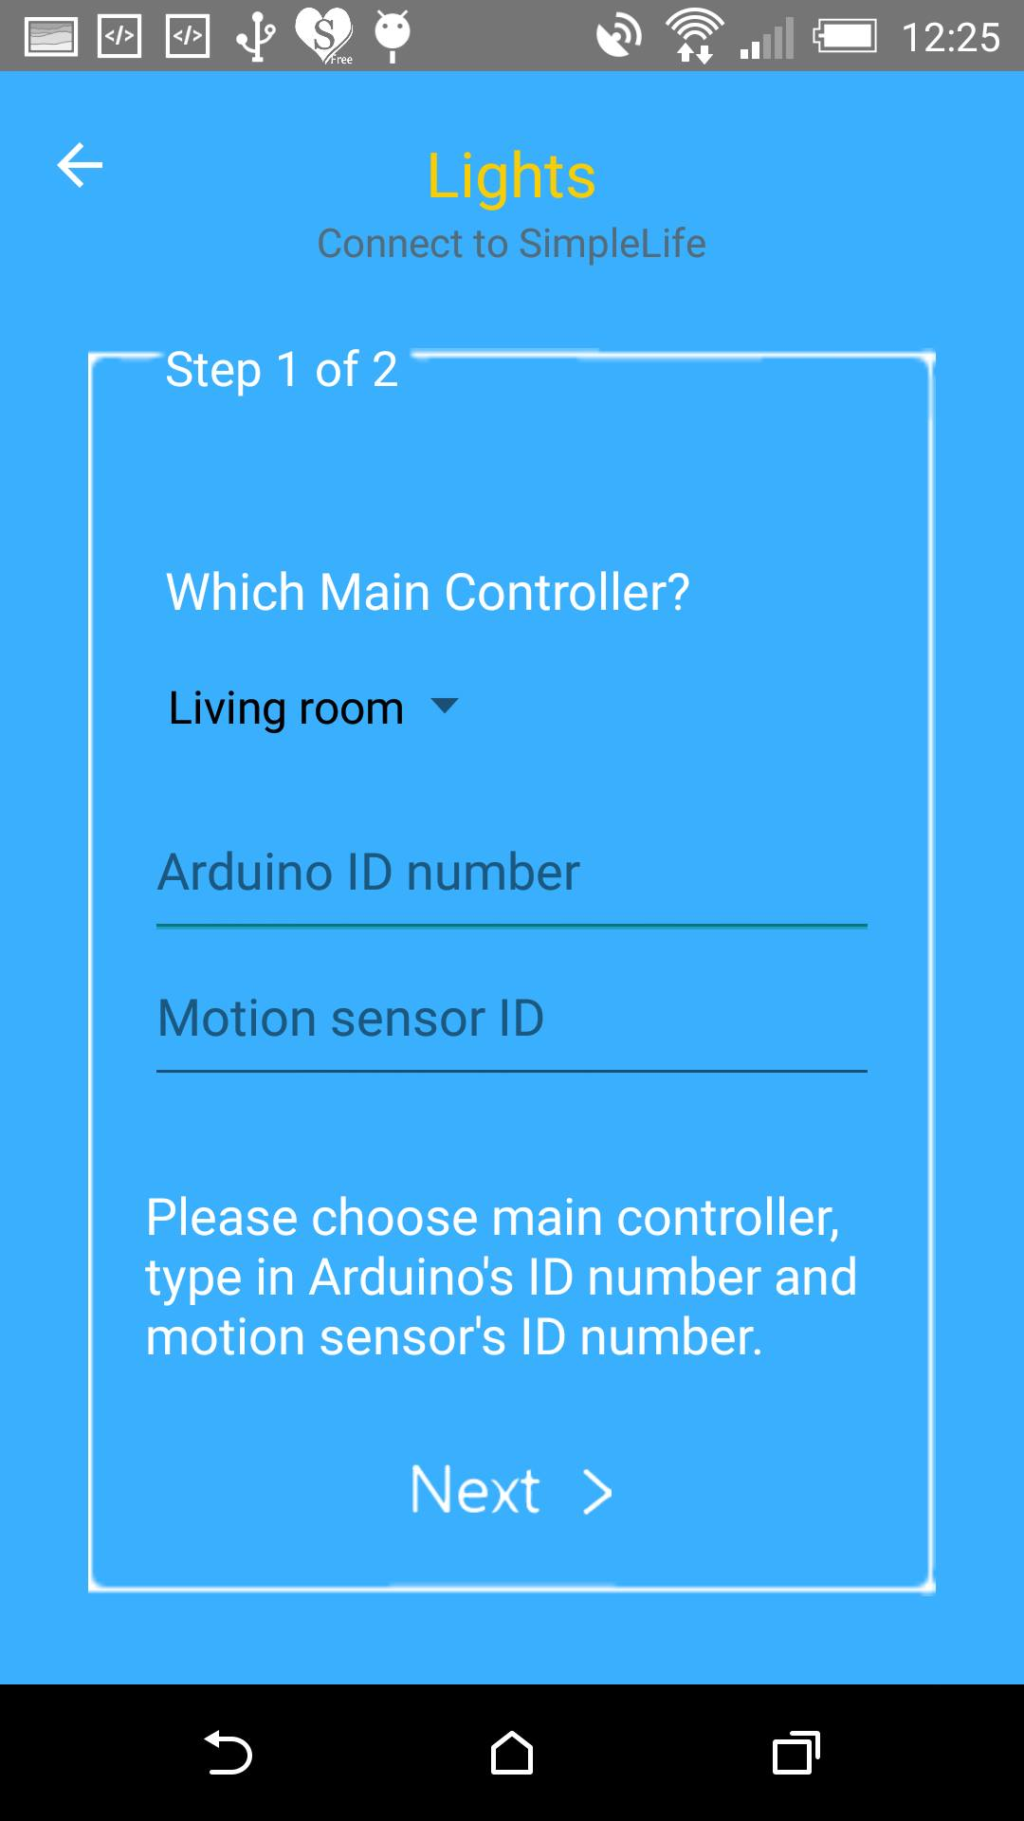
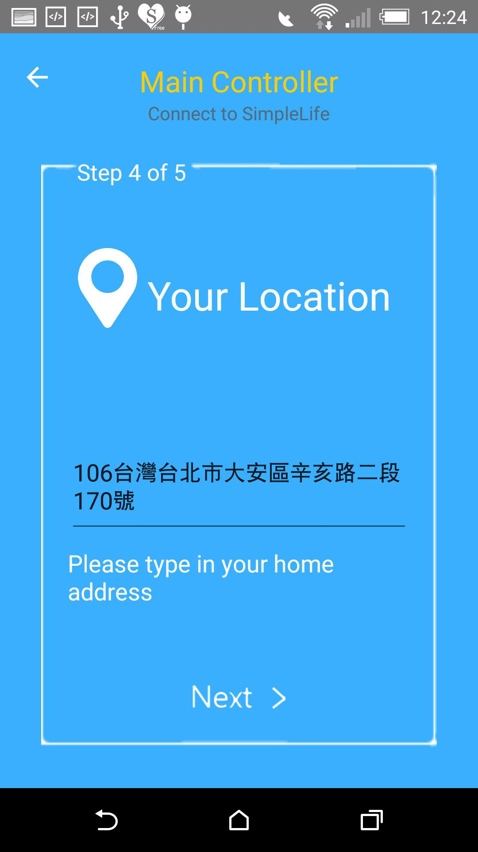
System Implementation
GPS Locator tracks user position
Add new appliance

Slide 15
System Implementation
Scheduler - time setting
Save energy
Device info table
Main Controller can save history (iterator)
Using socket to connect Arduino and main controller

Slide 16
Demo

